Slide 1
Redfern Inventory Manager System
By Christian Redfern

Slide 2
Introduction
With this project, I set out to create an inventory management system based on Java capable of manipulating a mySQL database on GCP.
The project specification demands CRUD functionality for three different tables: customers, products, and orders.
The project also needed a means to change the contents of an order and calculate the total cost.
Other features are optional, though there's room for them.

Slide 3
Project Management
The planning of this project utilised the MoSCoW method of prioritisation.
Musts
Add a customer to the system | Delete an item in the system
View all customers in the system | Create an order in the system
Update a customer in the system | View all orders in the system
Delete a customer in the system | Delete an order in the system
Add an item in the system | Add an item to an order
View all items in the system | Calculate a cost for an order
Update an item in the system | Delete an item in an order

Slide 4
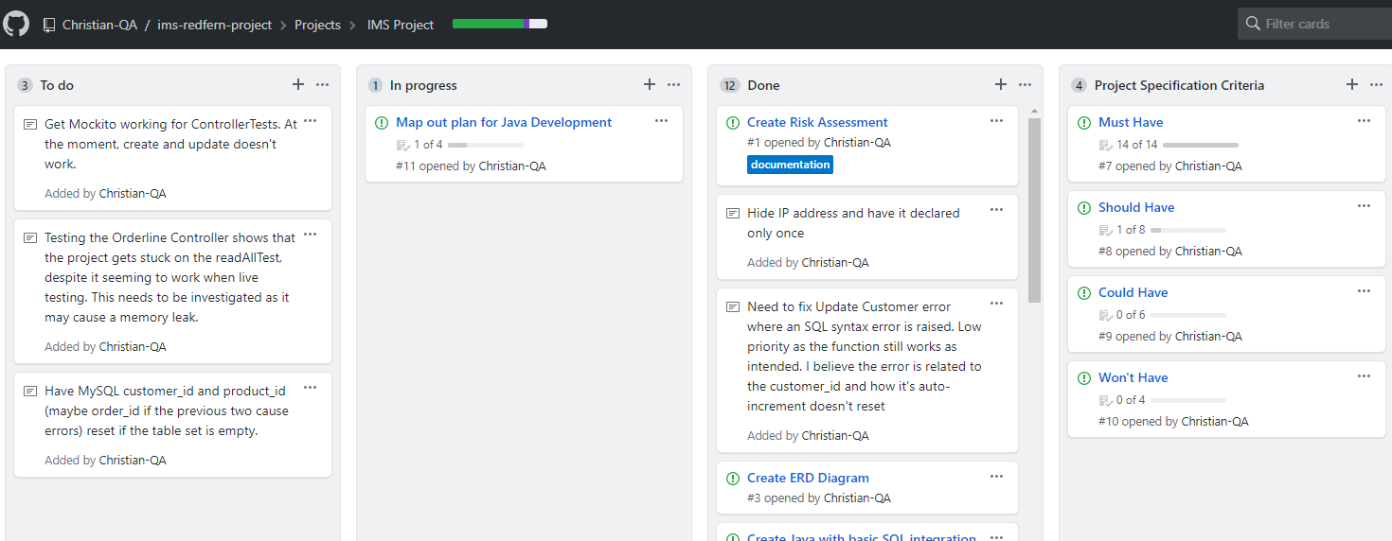
Further planning

Slide 5
Risk Assessment
A risk assessment was made before starting the project.
The risks covered potential issues from coronavirus to security breaches to management issues.
The full assessment can be found in the repository.

Slide 6
Journey to Completion
Things I learnt on the way:
Time efficiency
Sticking to the plan
More complex usage of Java, mySQL and other technologies
SonarQube is amazing

Slide 7
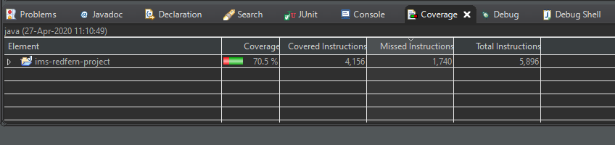
Coverage
Tests were undertaken using JUnit, Mockito and SonarQube.
Overall the project reached 70.5% coverage with JUnit and Mockito
And 53.3% coverage on SonarQube.

Slide 8
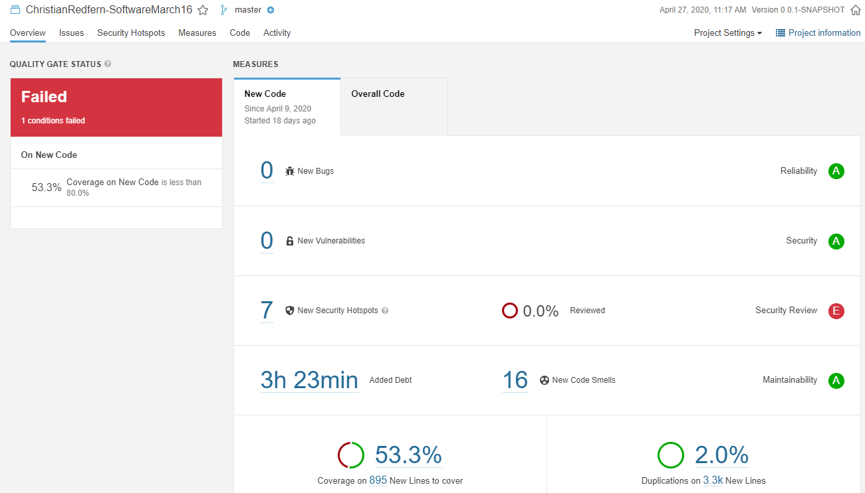
SonarQube

Slide 9
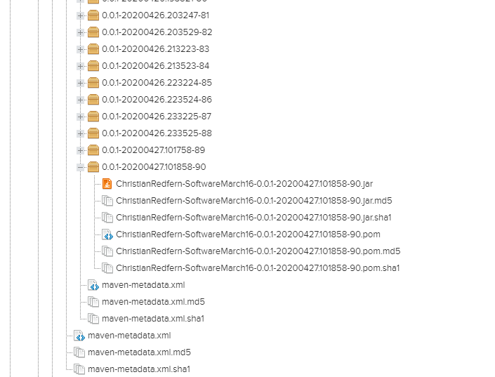
Nexus
Screenshot of far jar in
Nexus Artifact Repository

Slide 10
GitHub Branch
The branch model can be found in the repository

Slide 11
Instructions of Use
The project comes with an extensive README covering everything a user will need to know.
How to use it as of the current version follows a fairly strict set of commands.
The README can be found in the GitHub repository.

Slide 12
Improvements
Better planning
More focus on the musts
Testing along the way
Ease of use

Slide 13
Any Questions?

